Slide 1




Dynamic Test Paper Generator with Large Language Models
Encapsulating Bloom’s Taxonomy
A MINI PROJECT REPORT SUBMITTED IN PARTIAL FULFILLMENT
OF THE REQUIREMENT FOR THE DEGREE OF
BACHELOR OF TECHNOLOGY
IN
ARTIFICIAL INTELLIGENCE AND MACHINE LEARNING
SUBMITTED BY
Name Univ. Roll No.
UNDER THE GUIDANCE OF
Mr. Priyanath Mohanty
(Project Supervisor)
Shounak Sarkar 11600921047
Priyam Pal 11600921032
Sagar Das 11600921036
Saptarshi Parui 11600921042
Amrit Bag 11600921005
Sayak Sinha Roy 11600921046
DEPARTMENT OF INFORMATION TECHNOLOGY
MCKV INSTITUTE OF ENGINEERING
(NAAC ACCREDITED “A” GRADE AUTONOMOUS INSTITUTE)
243, G.T. ROAD(NORTH), LILUAH
HOWRAH-711204

Slide 2


Overview
Problem Statement
What is LLM? Prompt Engineering? RAG?
How can we use it for test paper generator?
WHAT HAVE WE DONE YET?
Benefits
Use Cases

Slide 3



PROBLEM STATEMENT
Develop a dynamic test paper generator using LLMs.
Incorporate Bloom's taxonomy to optimize the test's effectiveness.
Ensure the confidentiality of the institutions' private data and materials.

Slide 4
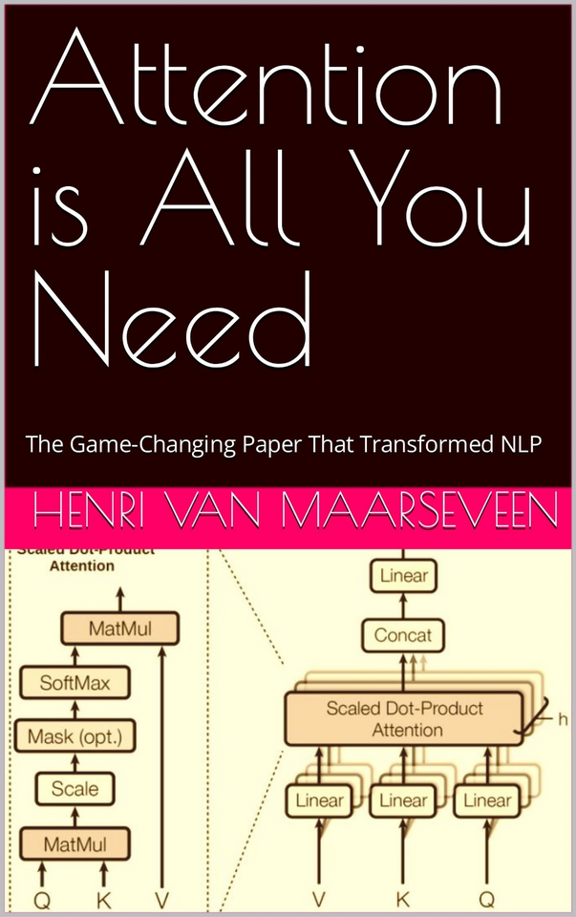

WHAT IS LLM?
LLMs are very large deep learning models
Trained on vast amount of data.
Underlying algorithm consist of the TRANSFORMER ARCHITECTURE
As suggested by the revolutionary paper: "Attention is all you need" in 2017
Calle Cualquiera 123, Cualquier Lugar

Slide 5

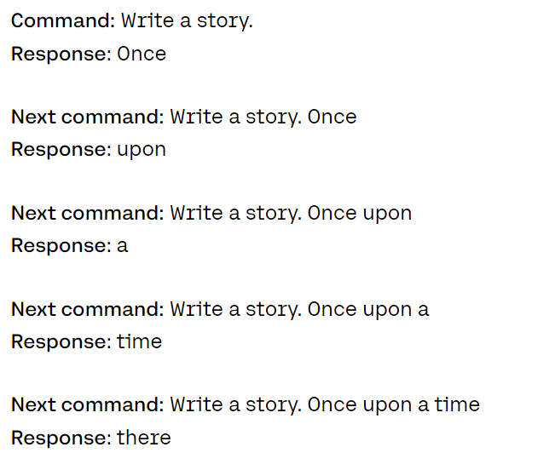
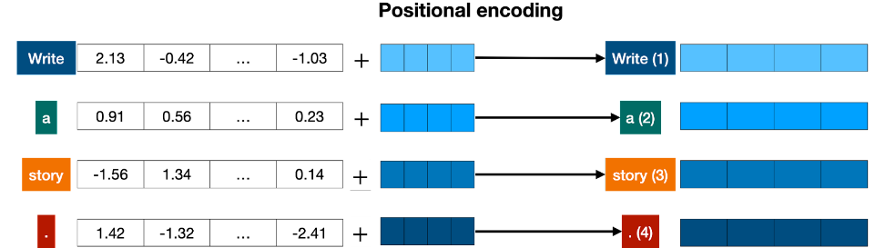
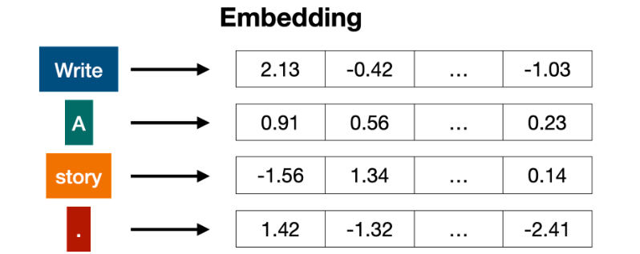
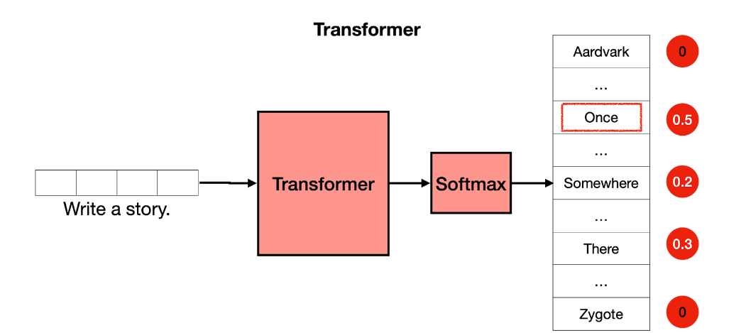
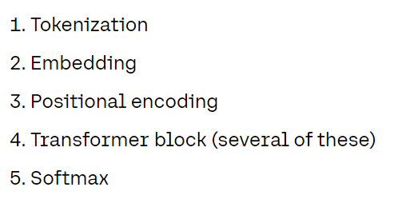

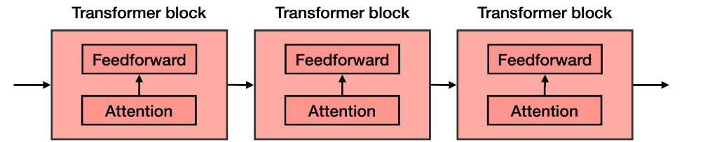

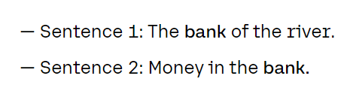
WHAT IS TRANSFORMER ARCHITECTURE?

Slide 6
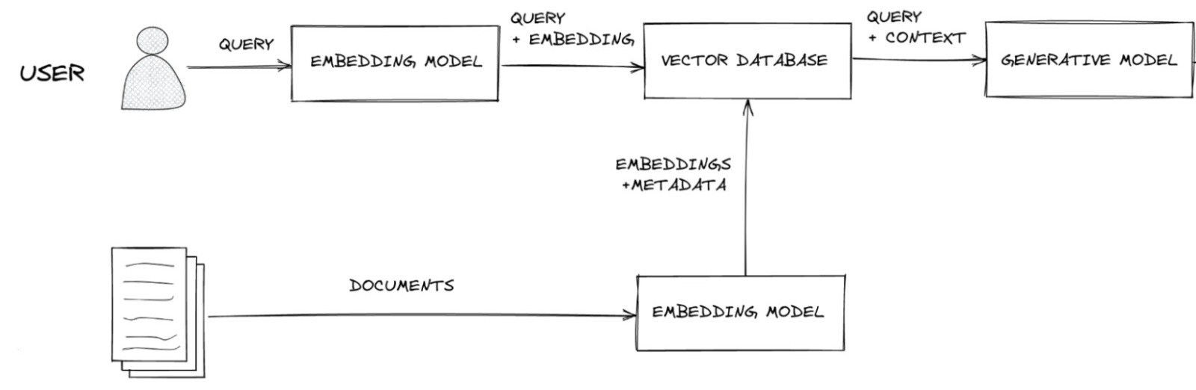
RAG ARCHITECTUTRE

Slide 7
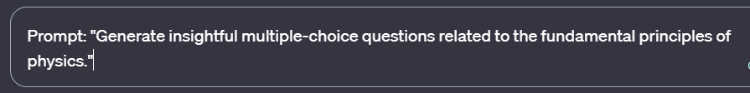
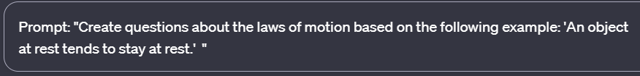
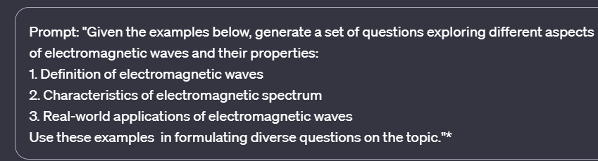

ALL ABOUT PROMPT ENGINEERING
Zero-shot Prompting
One-shot Prompting
Few-shot Prompting

Slide 8
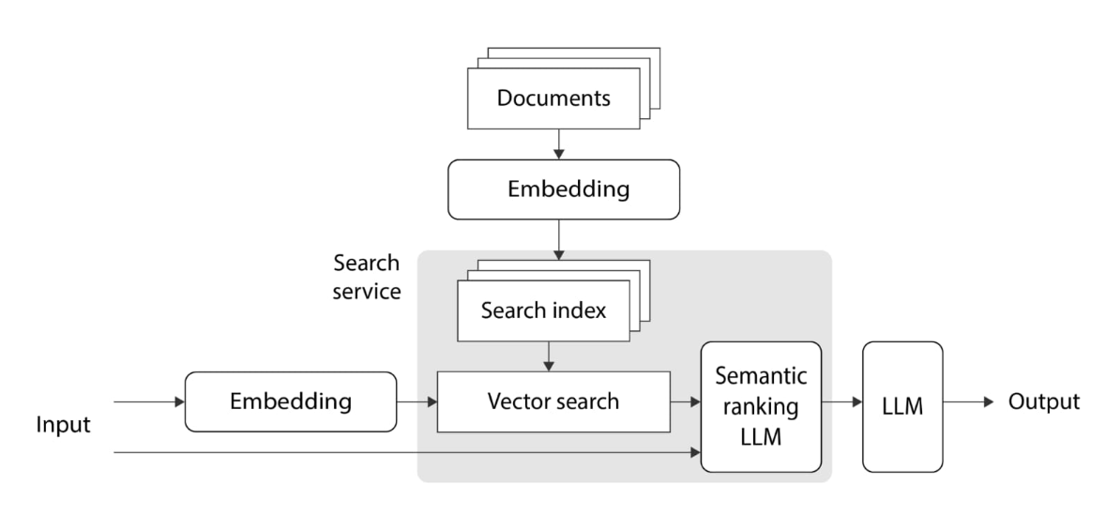
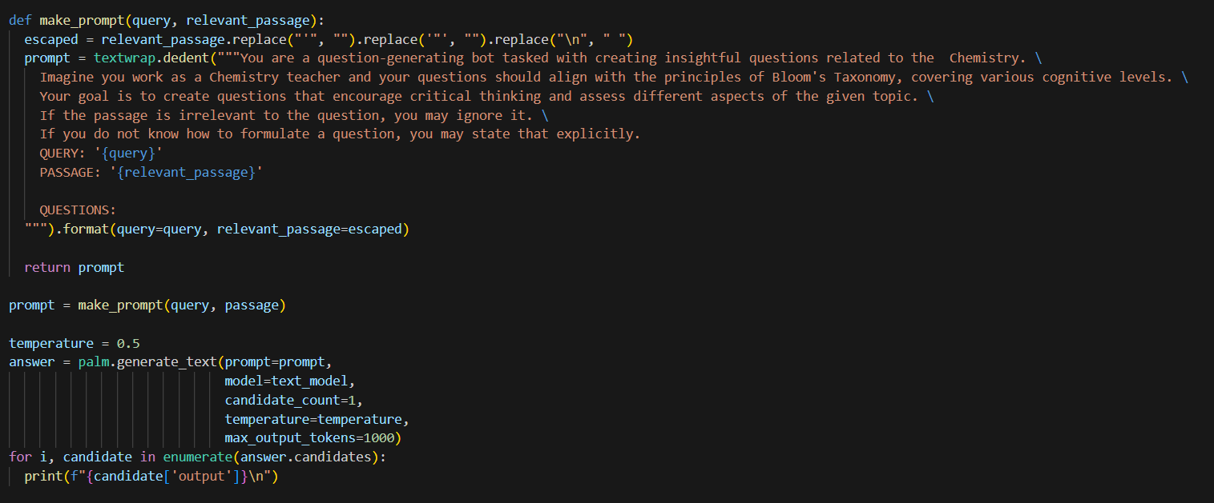
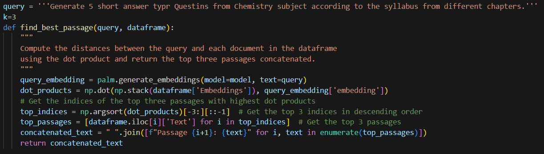
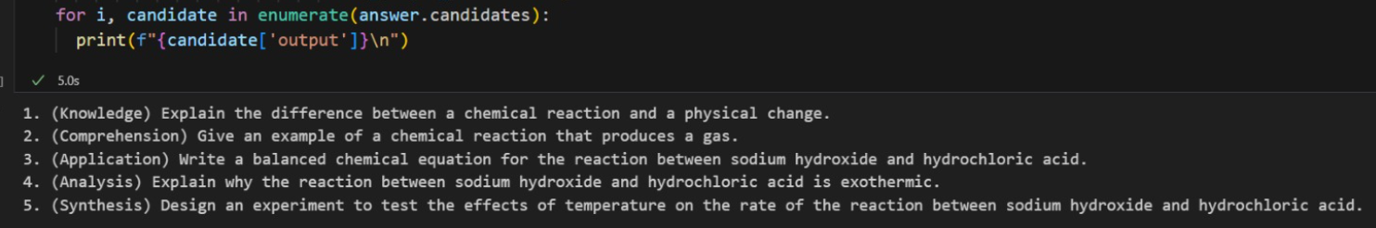
HOW CAN WE USE IT FOR TEST PAPER GENERATION?

Slide 9




DIFFERENT LLMs
GPT
BERT
Llama 2
Palm 2
KPI # 1

Slide 10
Use Cases and Applications
of LLMs
Natural Language Understanding (NLU).
Content Generation.
Question Answering Systems.
Personal Assistants and Chatbots.
KPI # 1

Slide 11

BENIFITS
Personalized and Adaptive Assessments
Enhanced Teaching Efficiency
Holistic Assessment of Cognitive Skills
Improved Quality of Education

Slide 12
USECASES
Formative Assessments
Summative Assessment
Standardized Testing Preparation
Remote Learning and Online Assessments
Curriculum Development and Alignment
KPI # 1

Slide 13
CHALLENGES
Can not generate diagrams or table-related Questions.
Sometimes it can generate repeated questions.
Irrelevant question due to hallucination.

Slide 14


THANK YOU!!!!

